Slide 1
SWE Project
Group 7
Dallas Gere, Victor Ekpenyong, Sam Randall

Slide 2
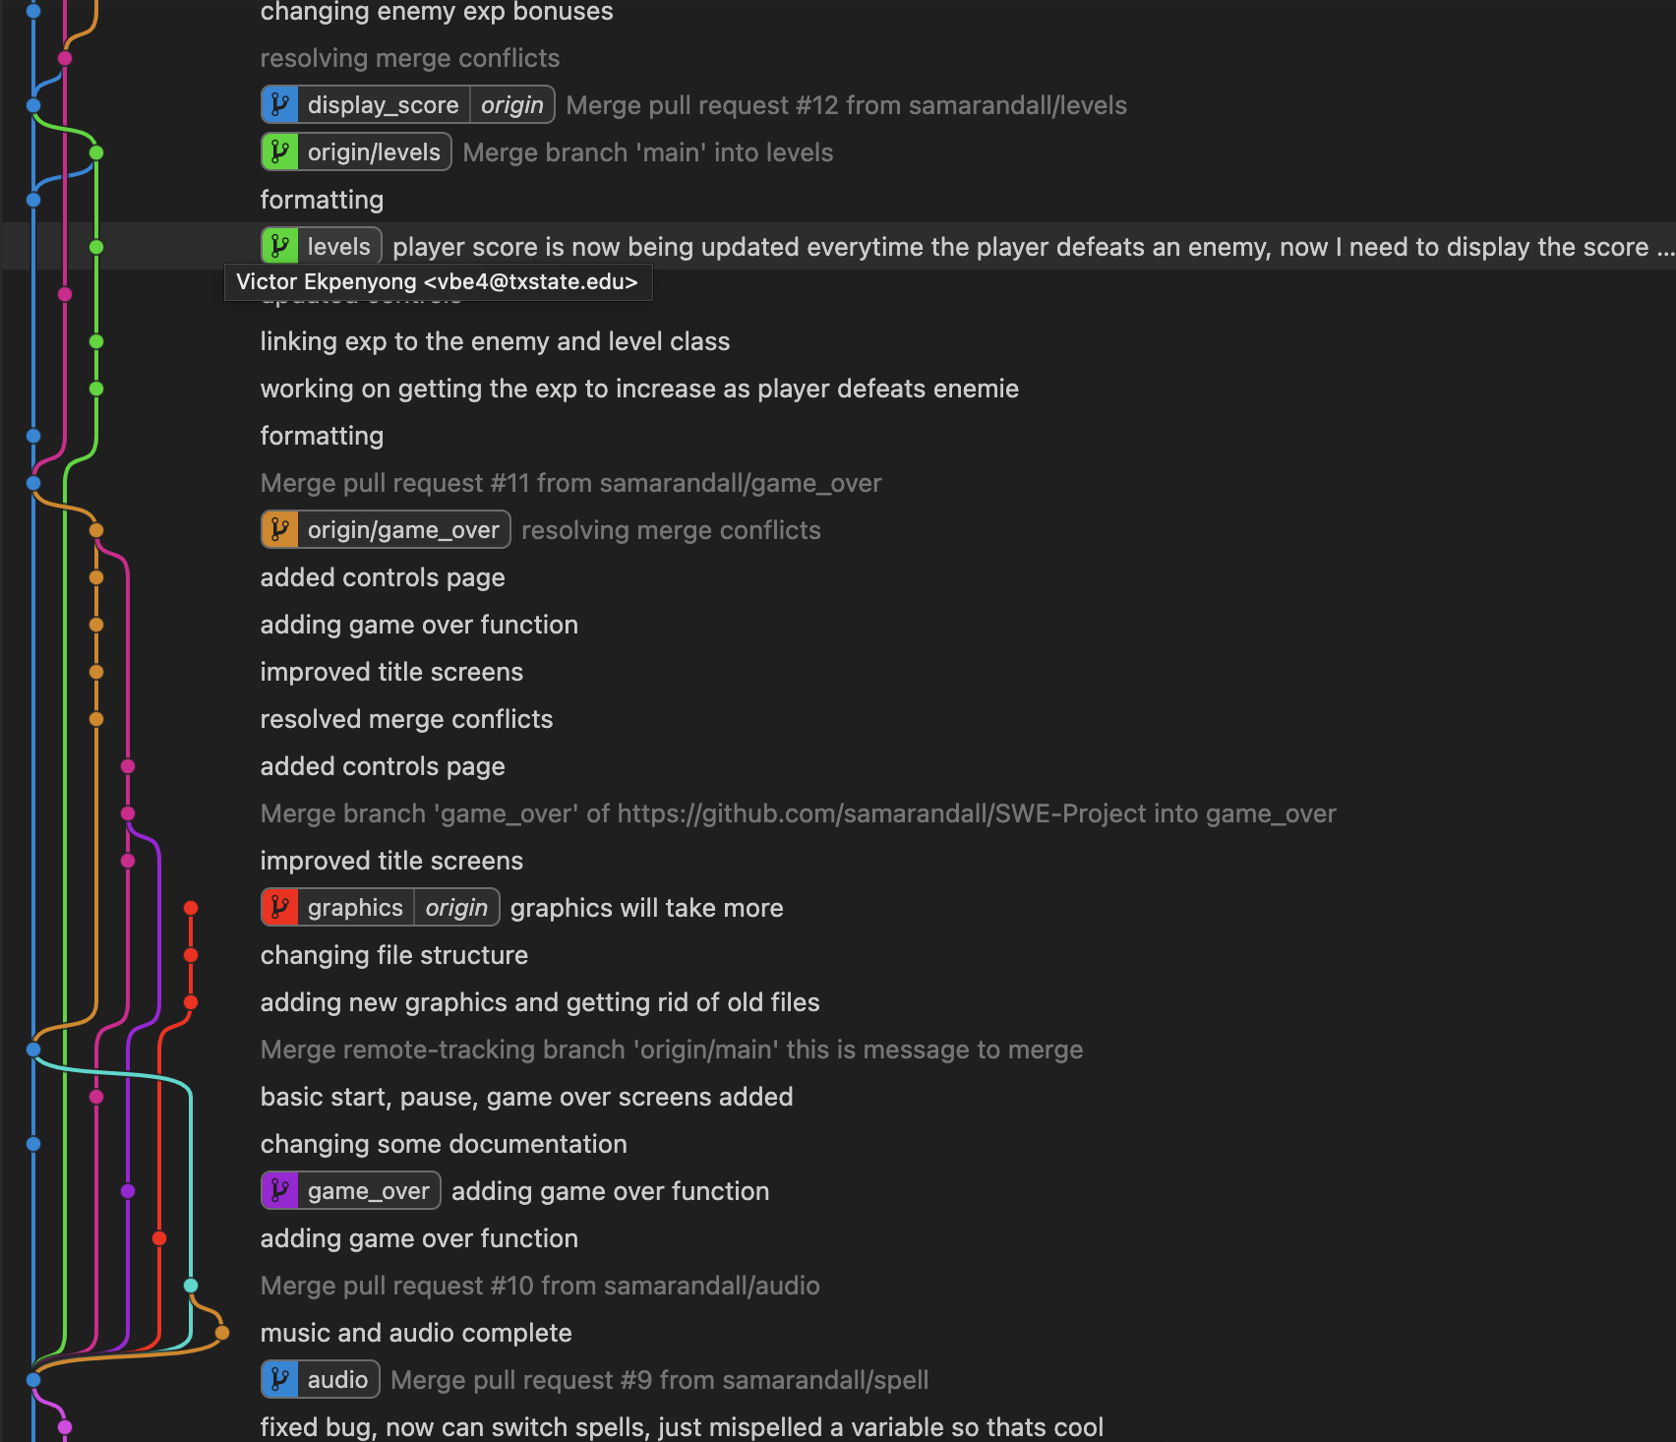
Network Tab for Git Graph
This is a representation of our git branches and commits. This isn’t all of them as we weren’t able to fit them all in one picture, but this is a part of it.

Slide 3
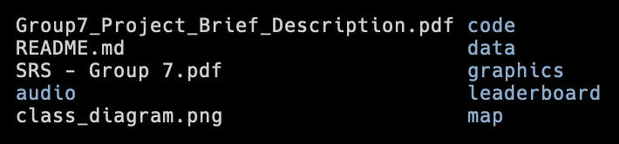
File Structure
All of our python files are in the code folder. This contains all our main game code and everything that we need to run the game
graphics pertain to the graphics, data, and map directories
audio contains all of our music and sound effects
We have a leaderboard directory which contains all the files we need for our leaderboard
Then we have all of our about the project folders in the top level directory
readme
class_diagram
SRS

Slide 4
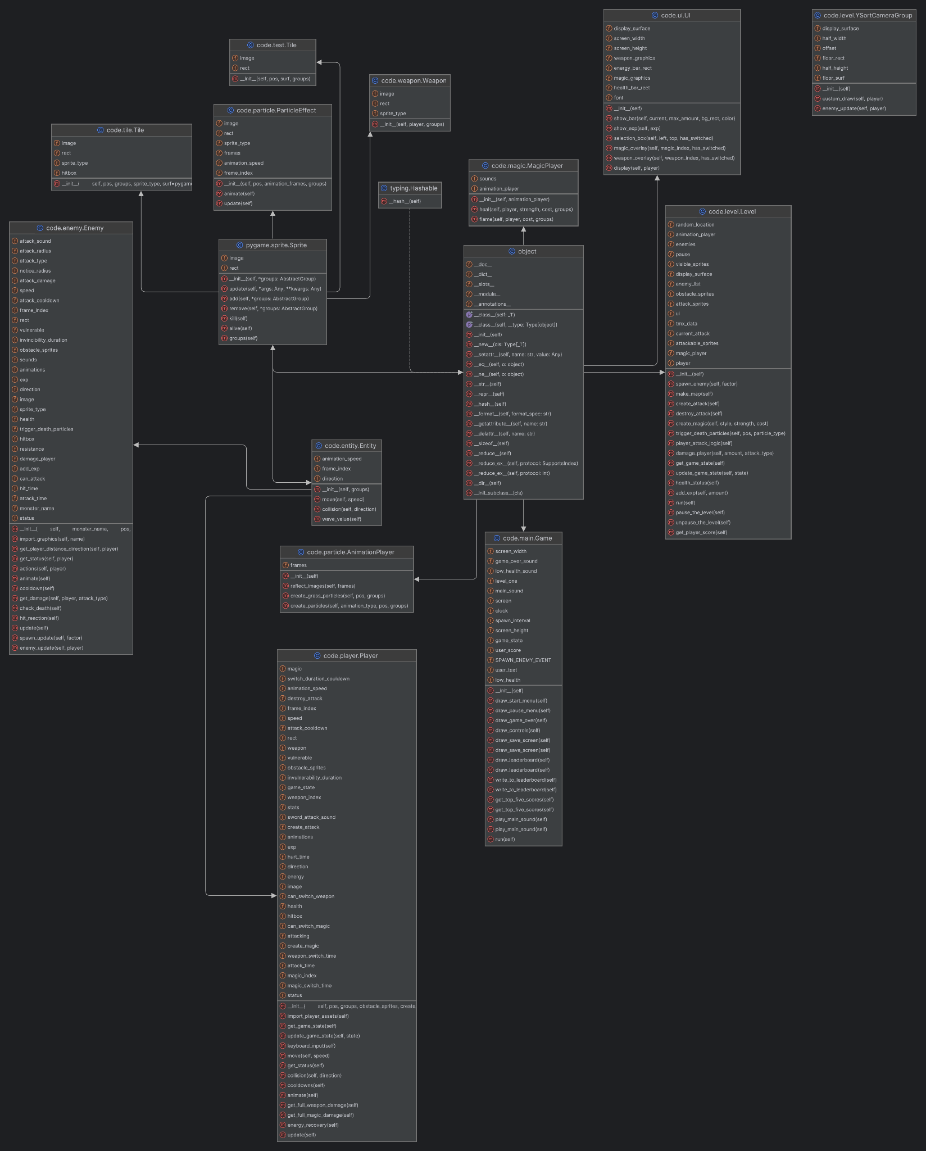
Class Diagram

Slide 5
Program Structure
The program starts within main.py where an instance of the Game class is made. Following this, the run() method within the Game class is called and this is how the game execution starts. The Game class can be seen as the super class or parent class since the execution originates from it, but it also inherits methods and variables from other classes such as Level and Player. The classes are interconnected with each other in an almost cyclic manner, but not completely. This means that many classes rely on each other for the game to run and the program to execute smoothly.

Slide 6
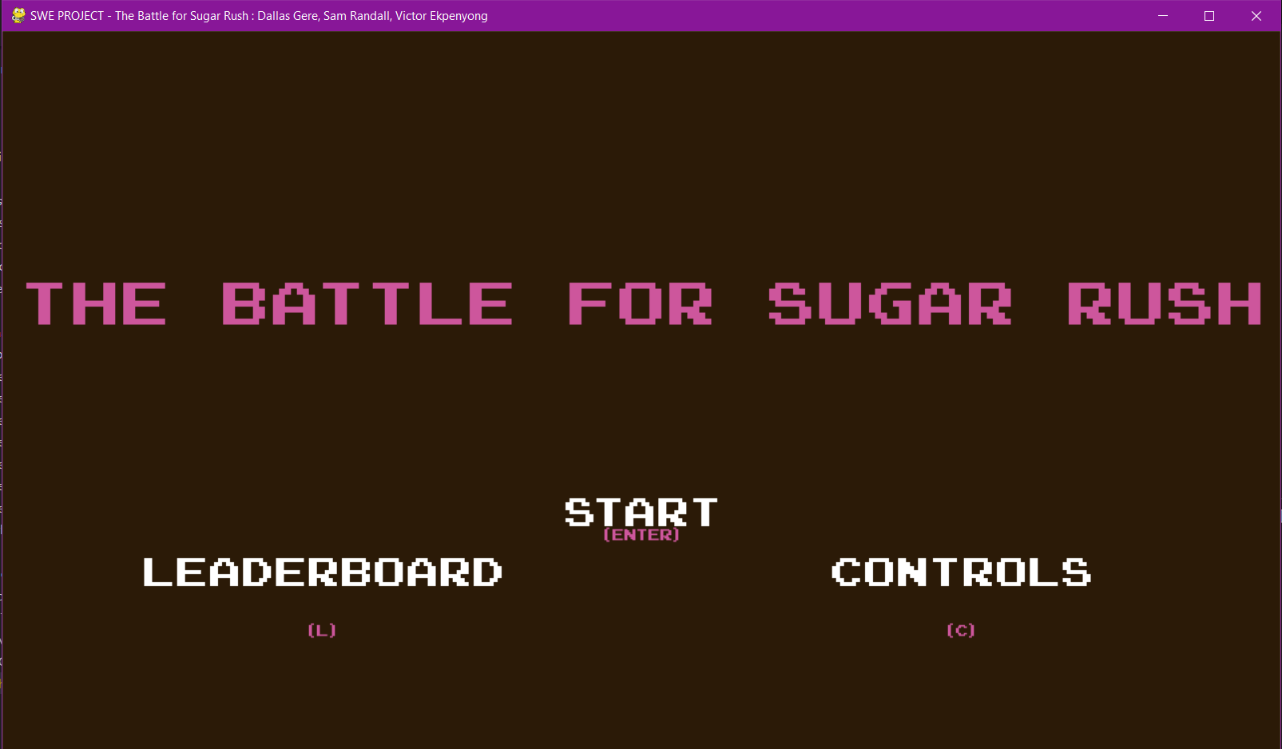
Game Screenshot - Start Screen

Slide 7
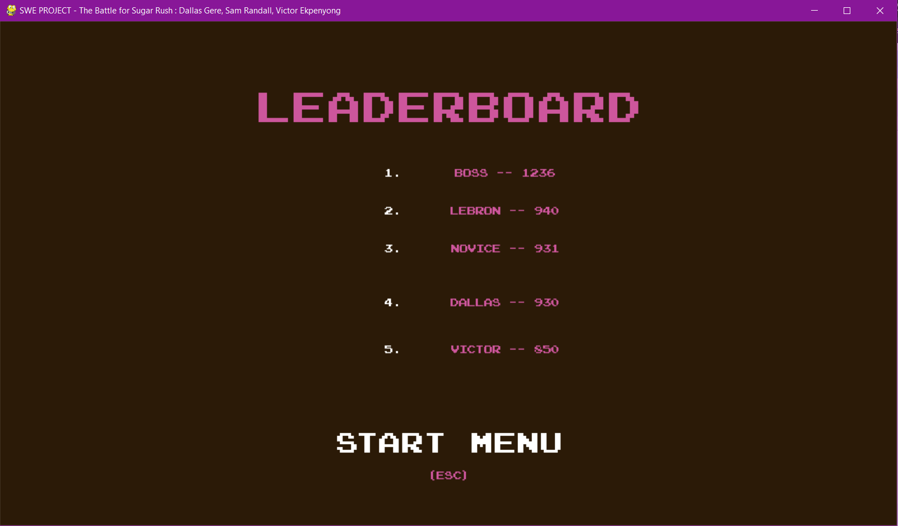
Game Screenshot - LeaderBoard Screen

Slide 8
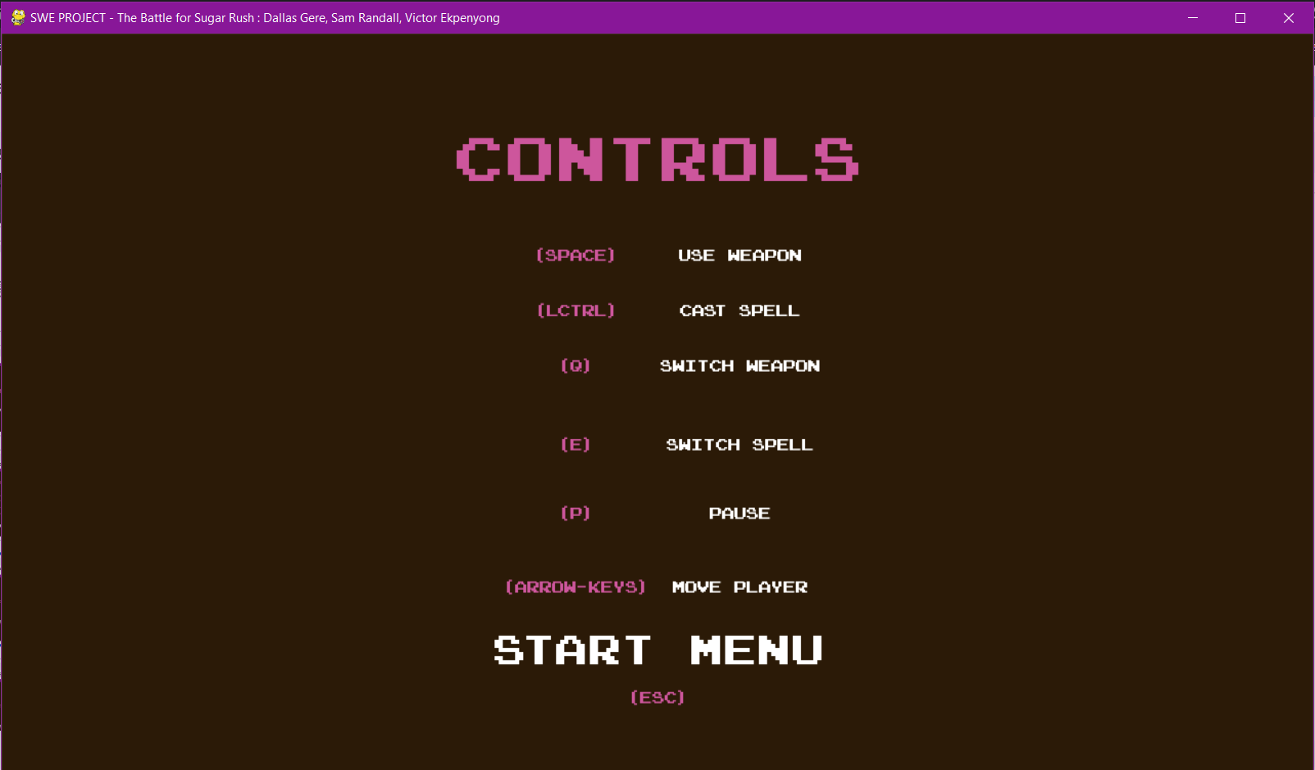
Game Screenshot - Controls Screen

Slide 9
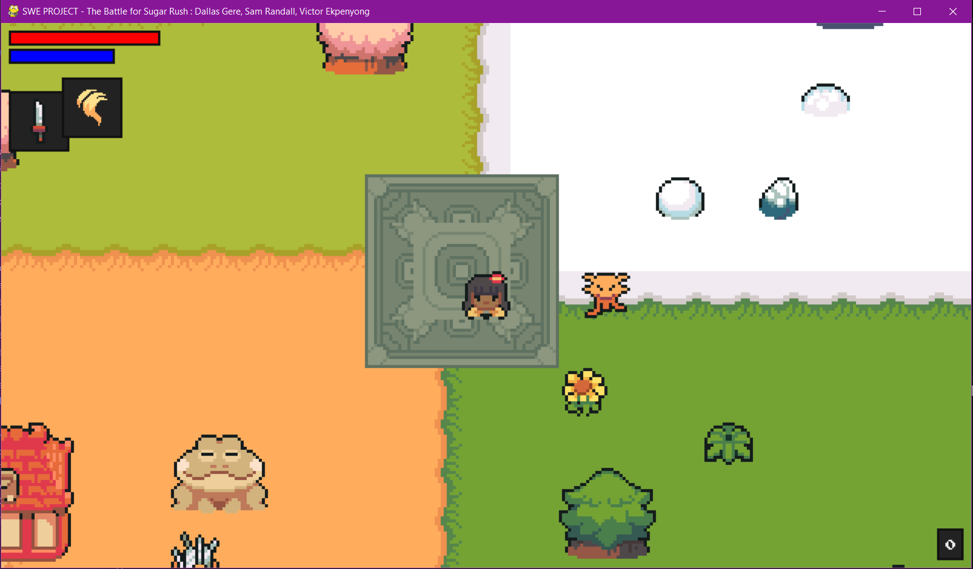
Game Screenshot - Game Running Screen

Slide 10
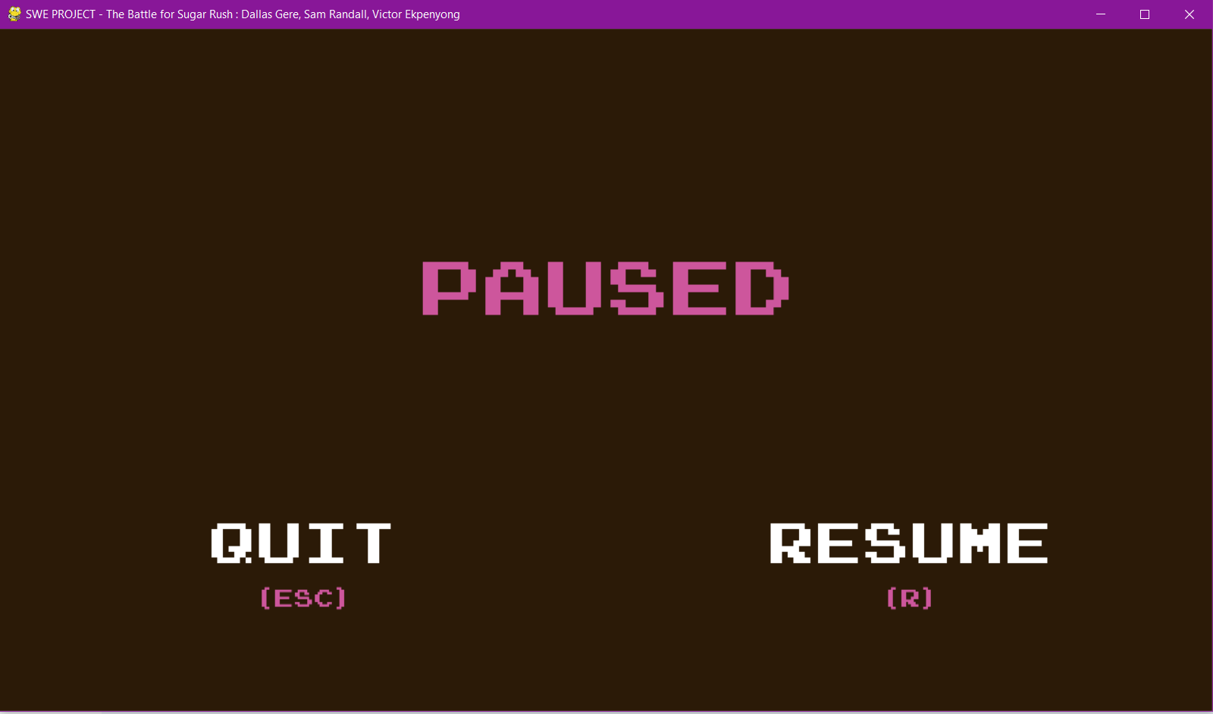
Game Screenshot - Pause Screen

Slide 11
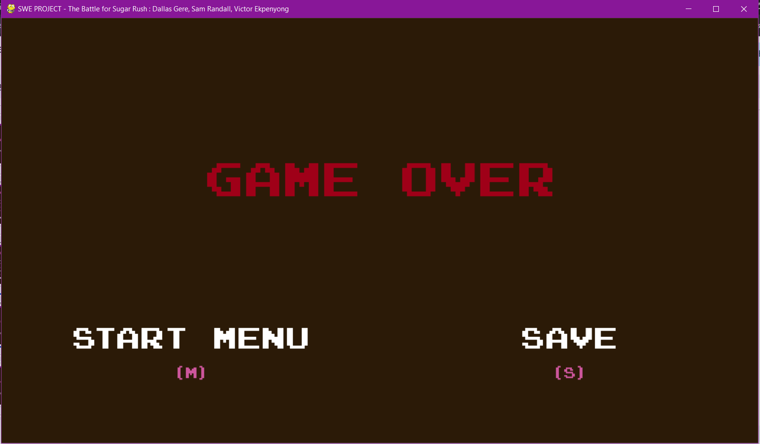
Game Screenshot - Game Over Screen

Slide 12
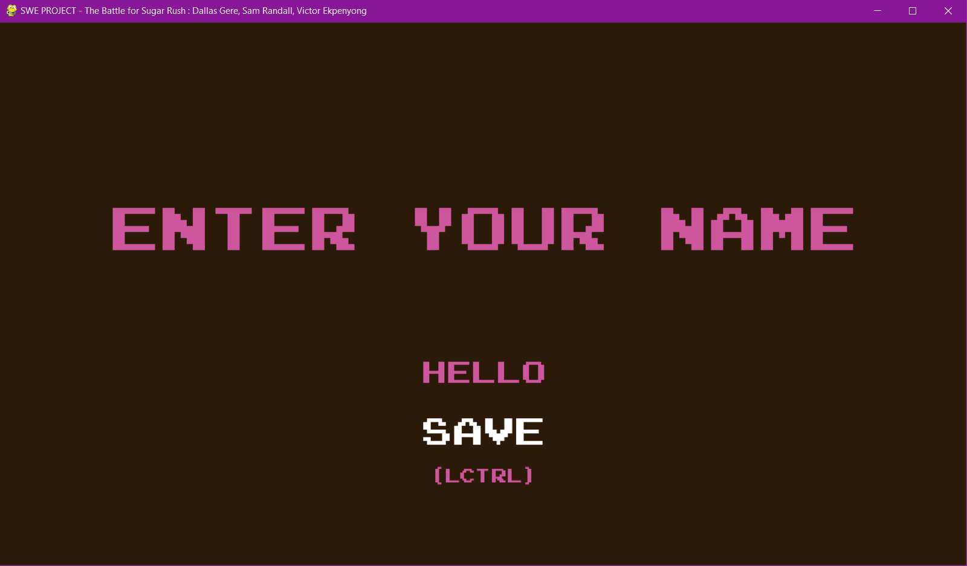
Game Screenshot - Save Score Screen

Slide 13
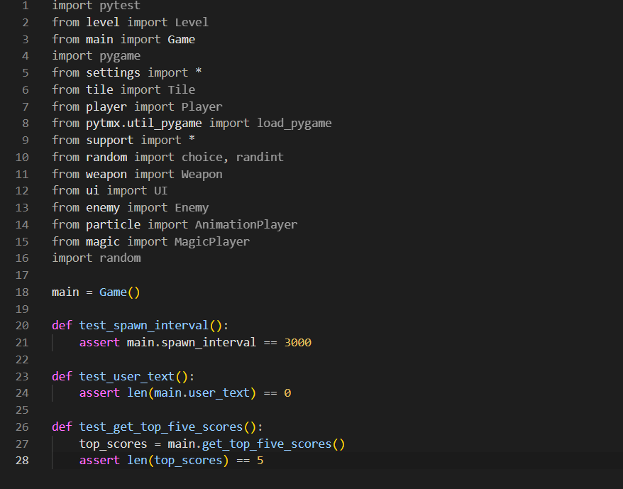
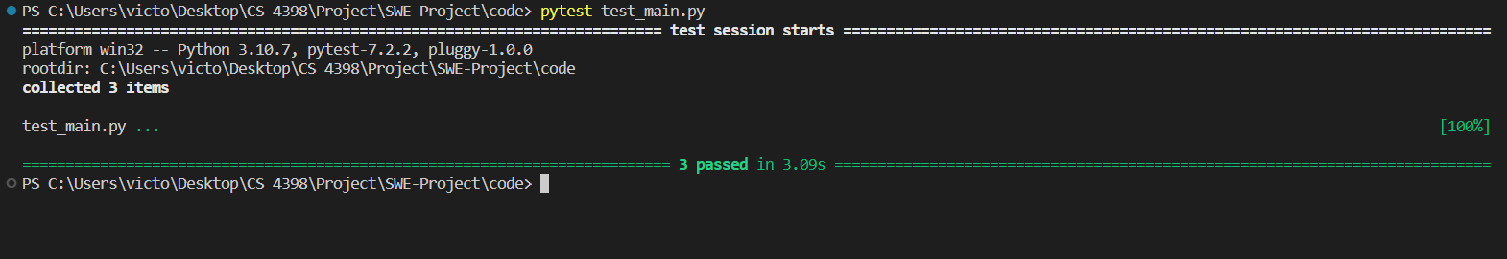
Main Unit Test

Slide 14
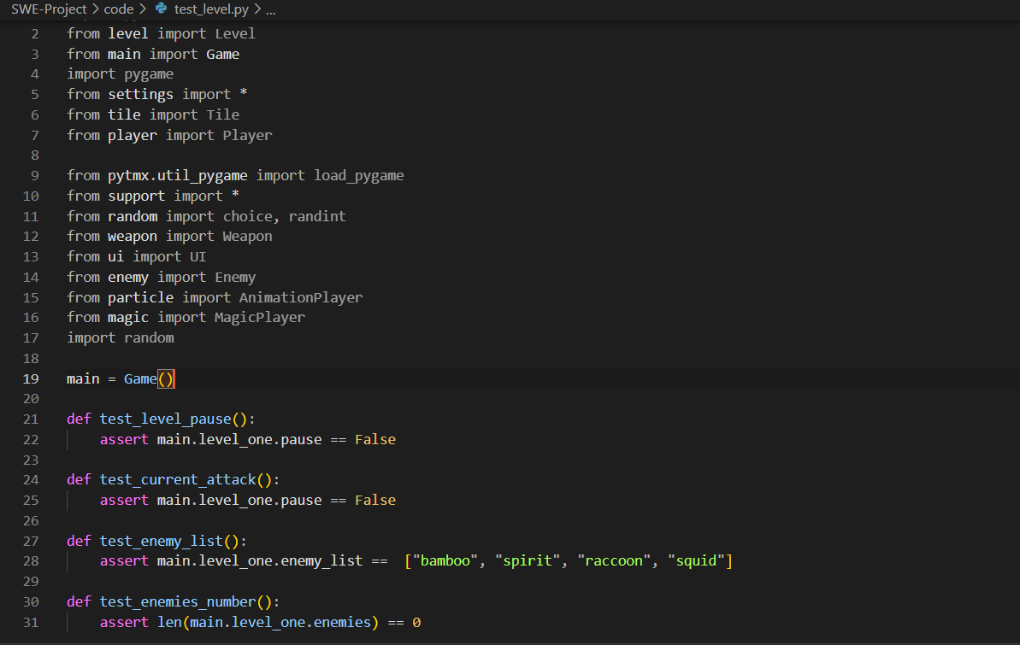
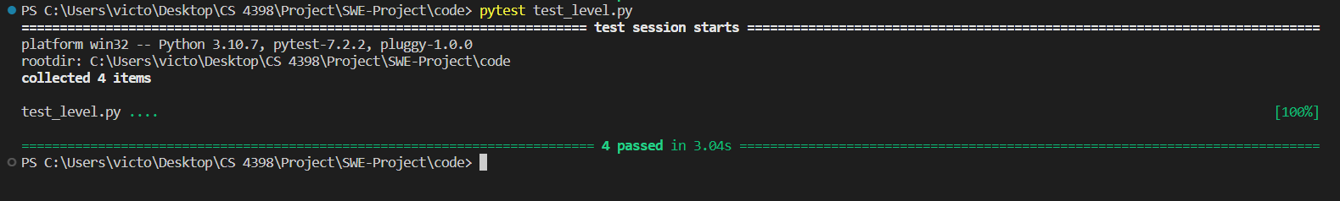
Level Unit Test

Slide 15
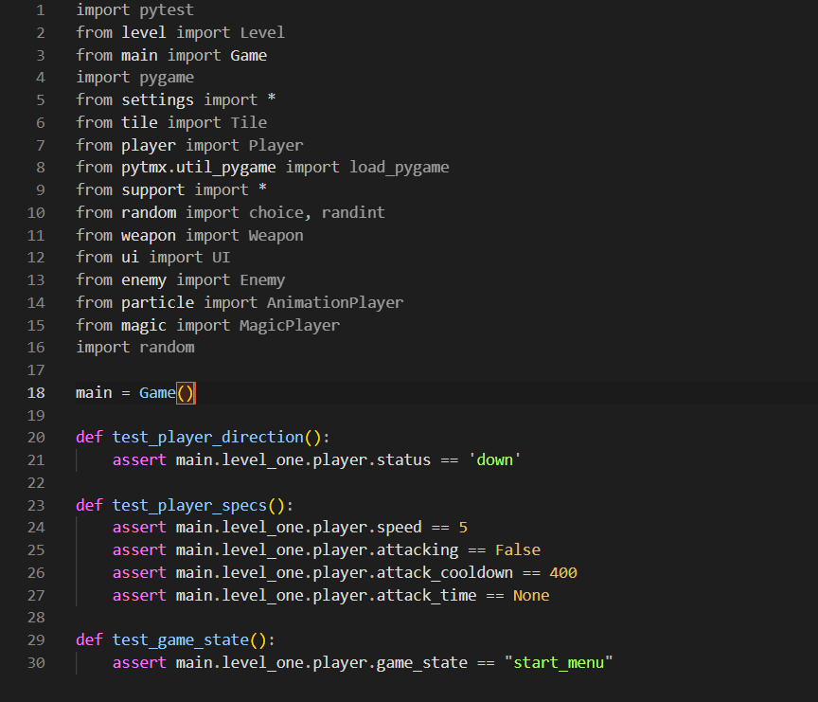
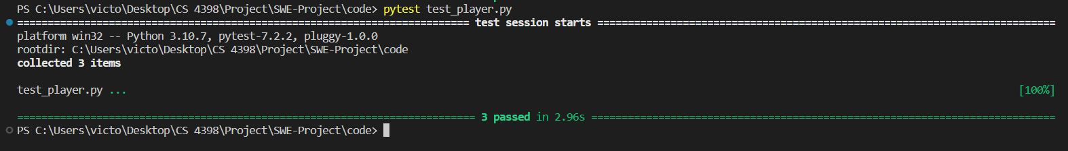
Player Unit Test

Slide 16
Graphics
We got our graphics from a free graphics pack from this website
https://pixel-boy.itch.io/ninja-adventure-asset-pack
We used the characters and animations from this graphics pack
We used the objects in this pack to make our own map

